Slide 1
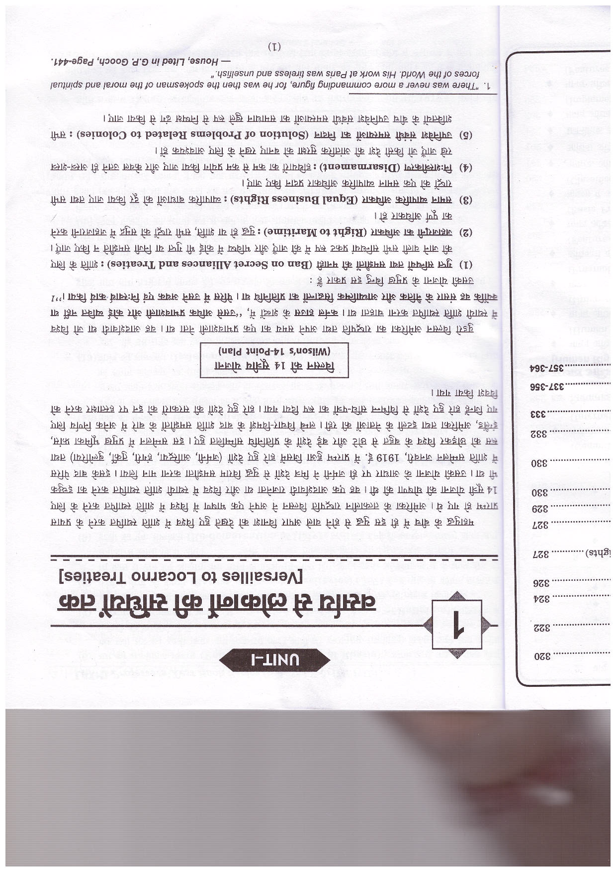
VERSAILLES TO LOCARNO TREATIES

Slide 2
WILSON’S 14-POINT PLAN

Slide 3
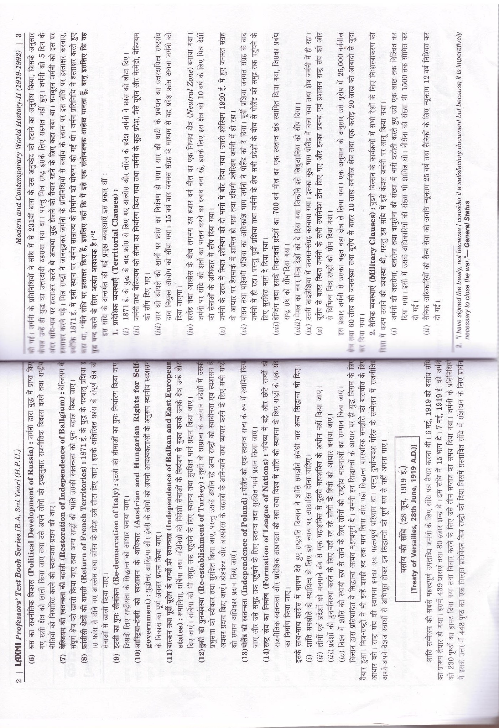

Slide 4
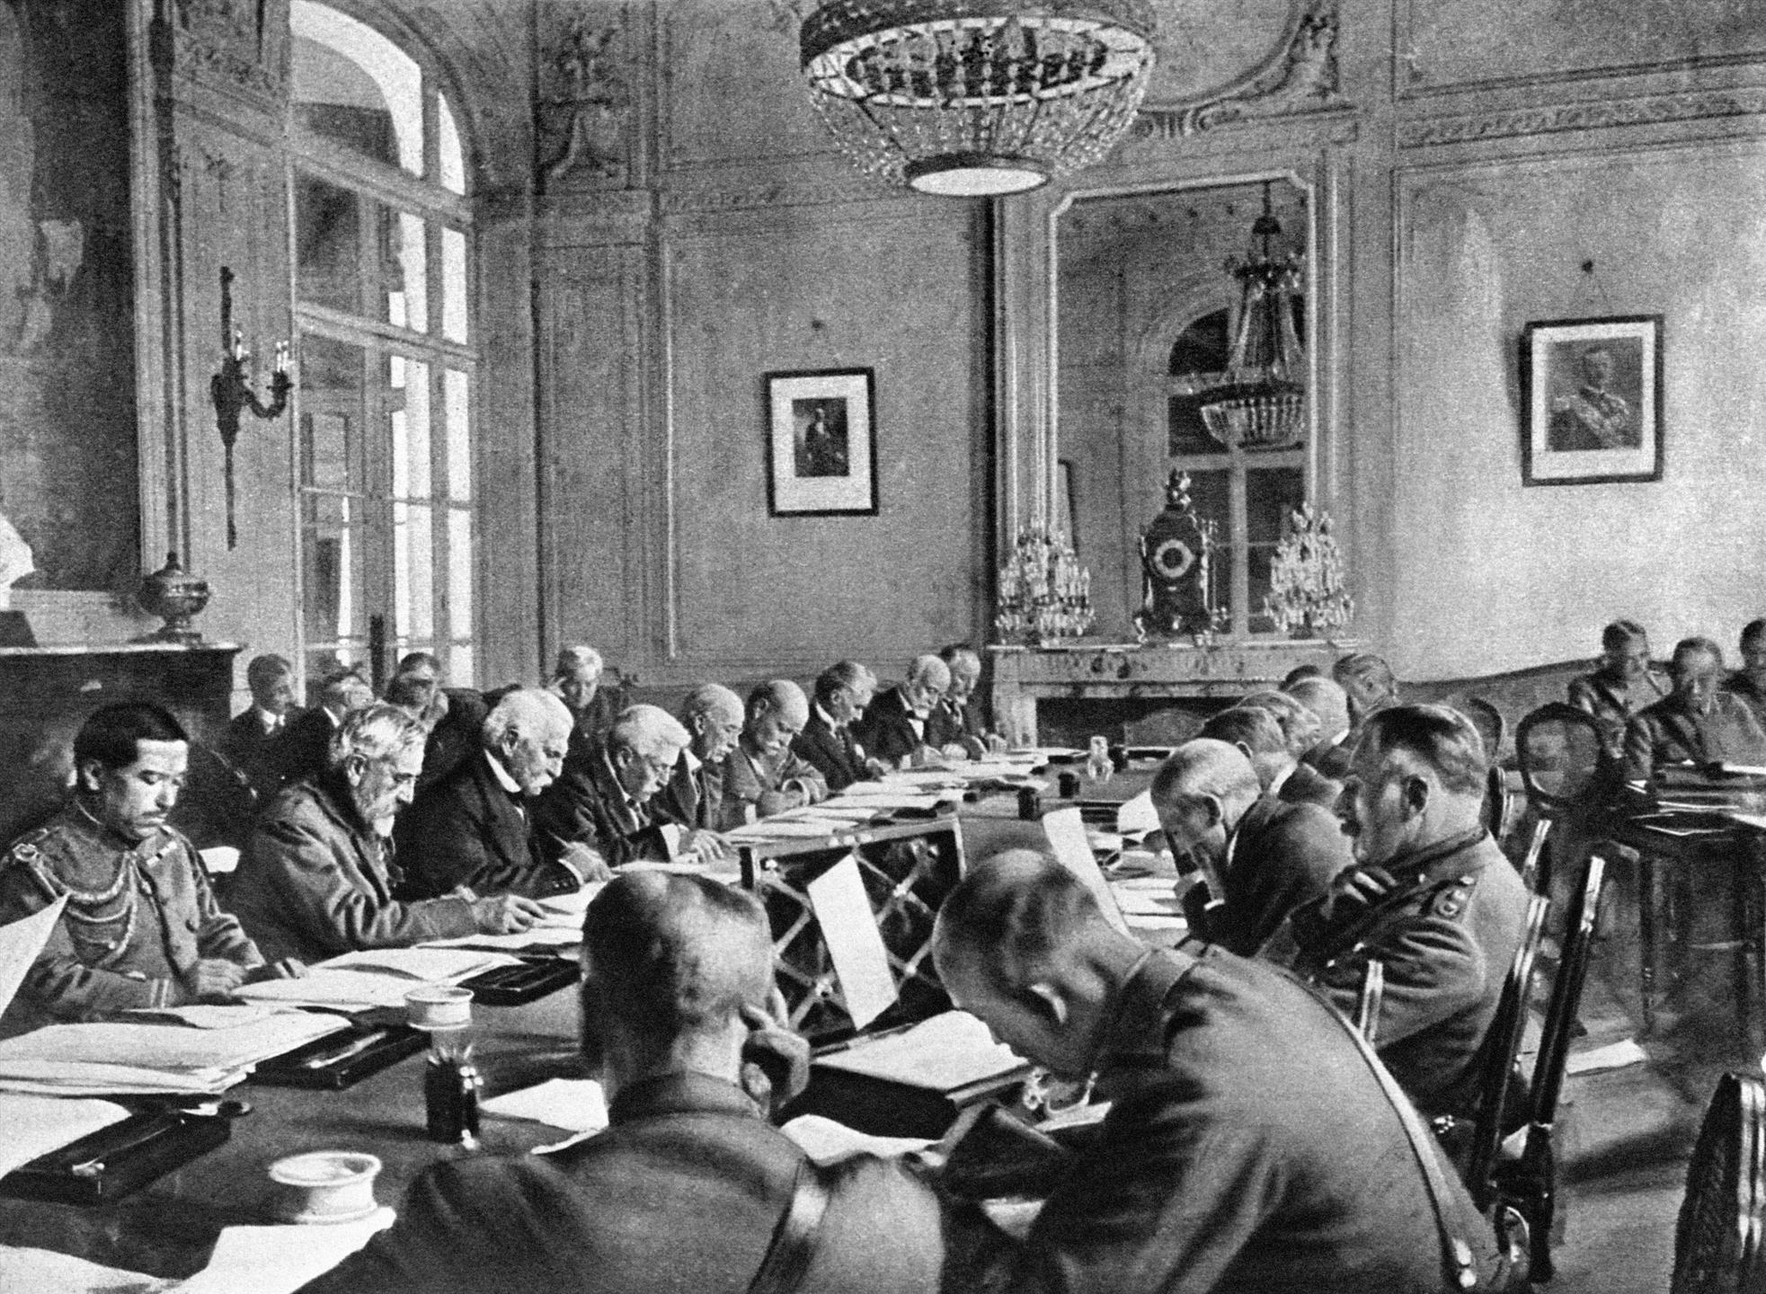
TREATY OF VERSAILLES, 28th June 1919 A.D

Slide 6
Territorial clauses

Slide 7
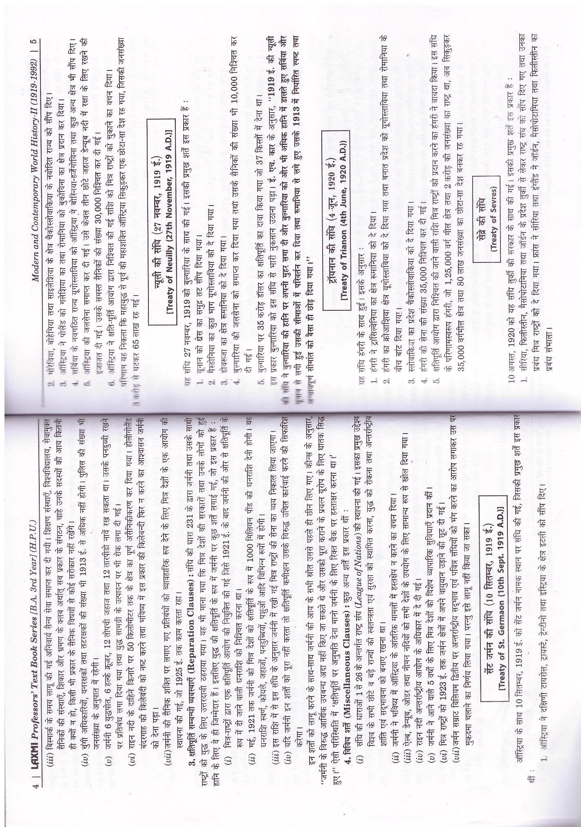
Military clauses

Slide 8
Reparation clauses

Slide 9
Miscellaneous clauses

Slide 10
Treaty of st. germaon (10 sept.1919 A.D)

Slide 11
Treaty of Neuilly (27th November ,1919 AD

Slide 12
Treaty of trianon(4th June, 1920 A.D)

Slide 13
Traty of sevres

Slide 14
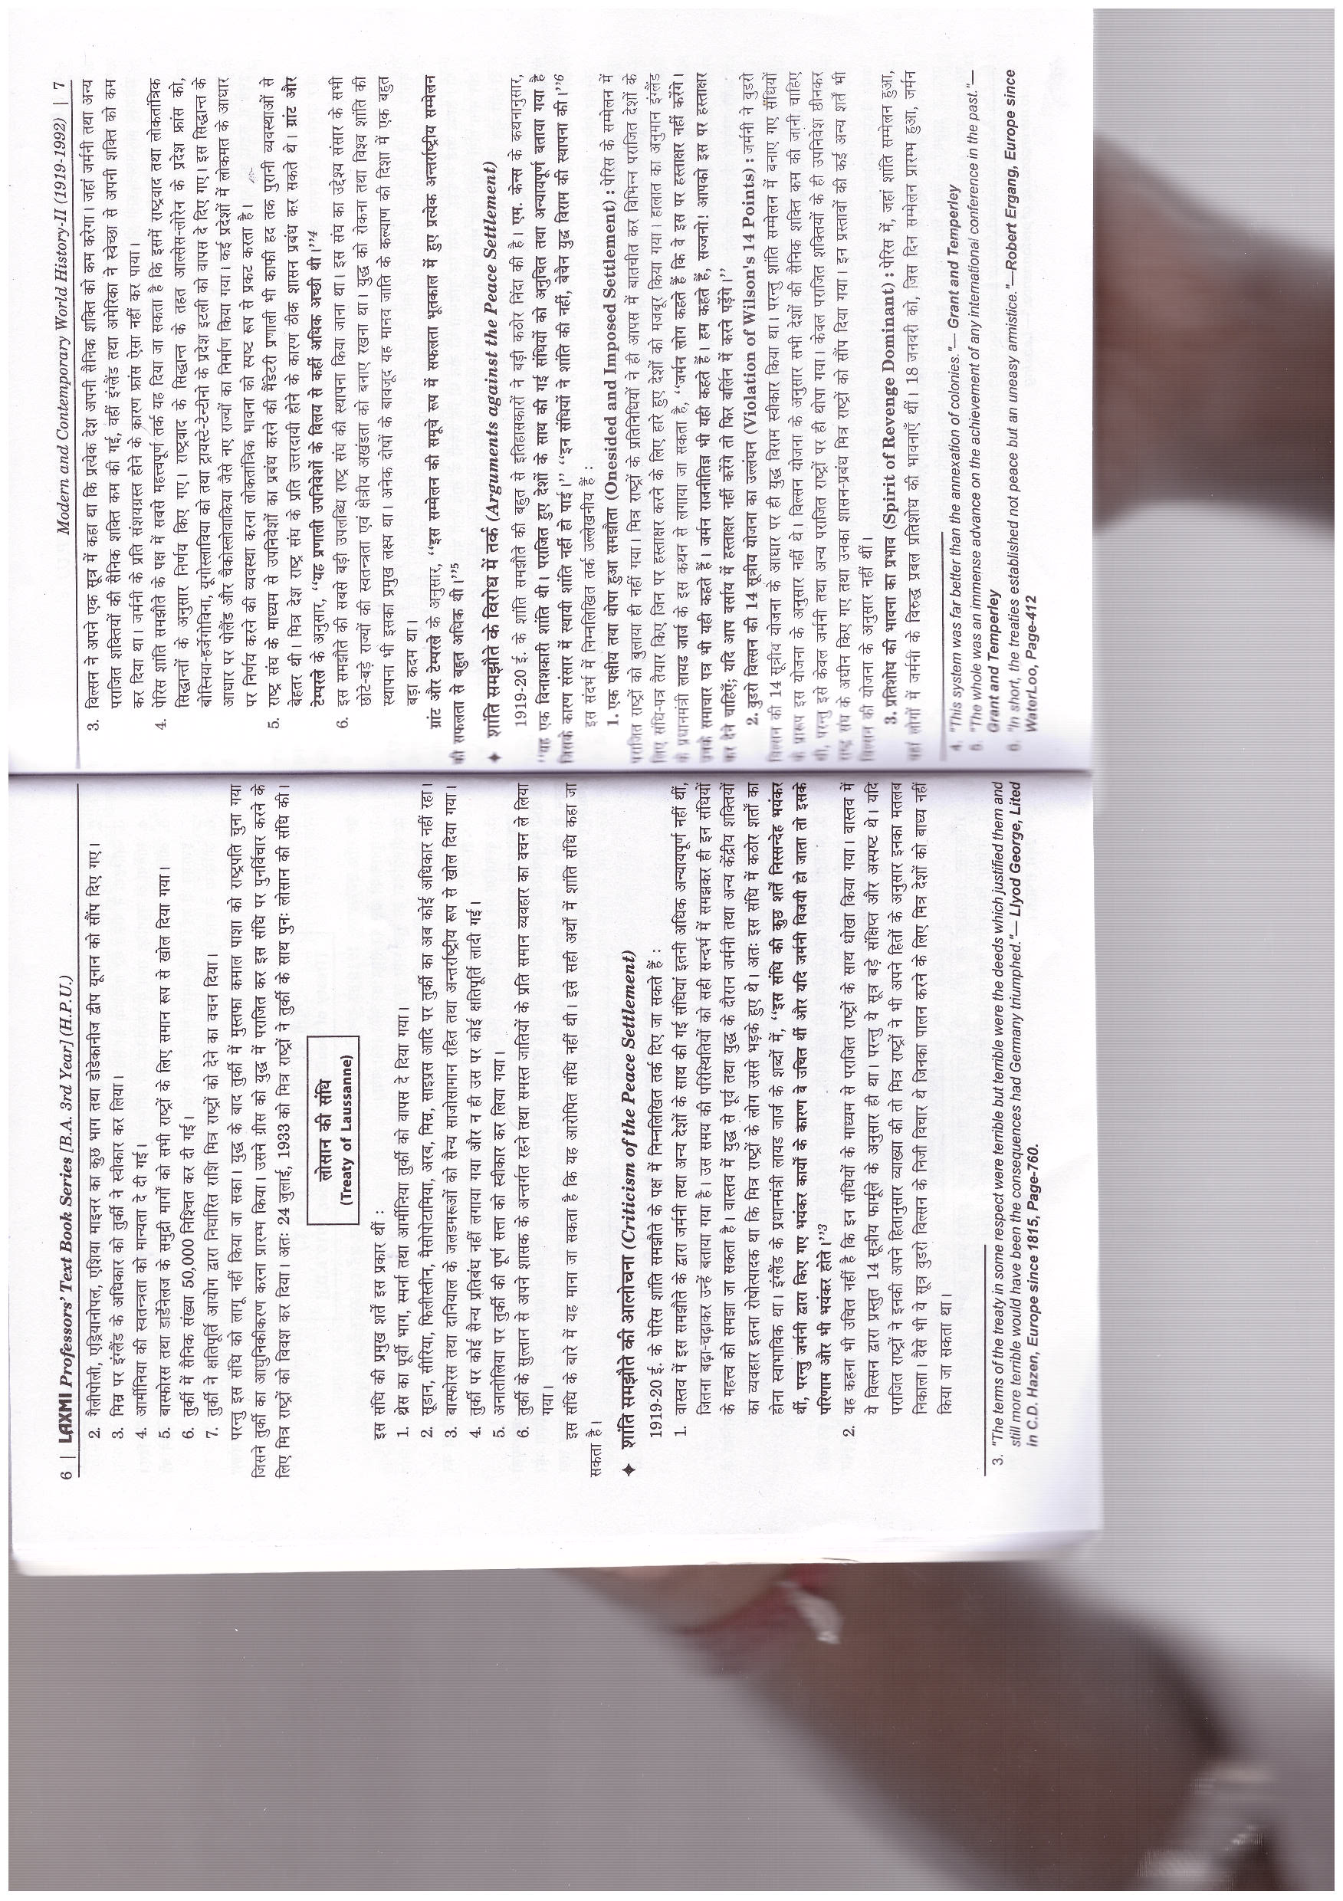

Slide 15
Treaty of laussanne

Slide 18
ARGUMENS AGAINST THE PEACE SETTLMENT

Slide 19
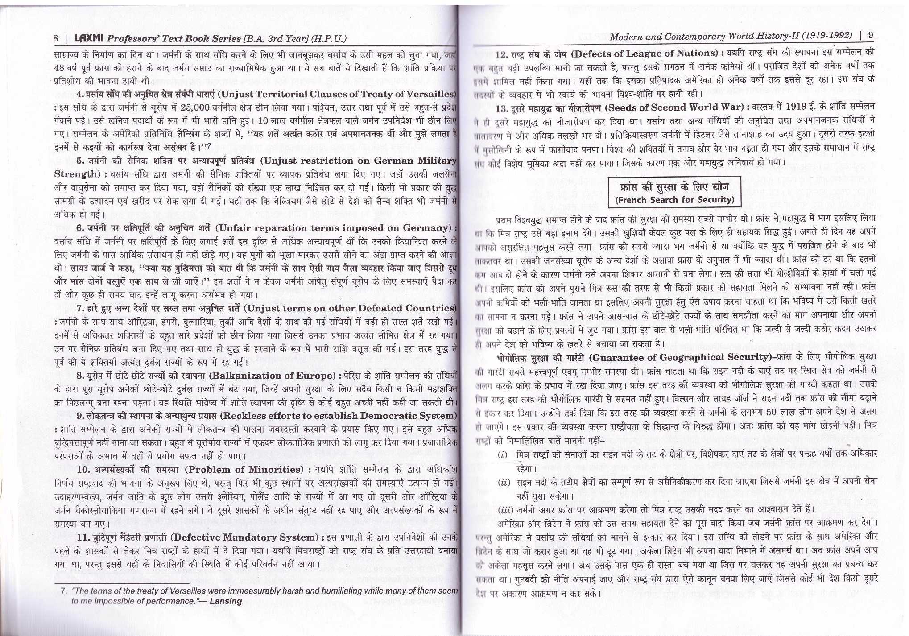

Slide 21
FRENCH SEARCH FOR SECURITY

Slide 22
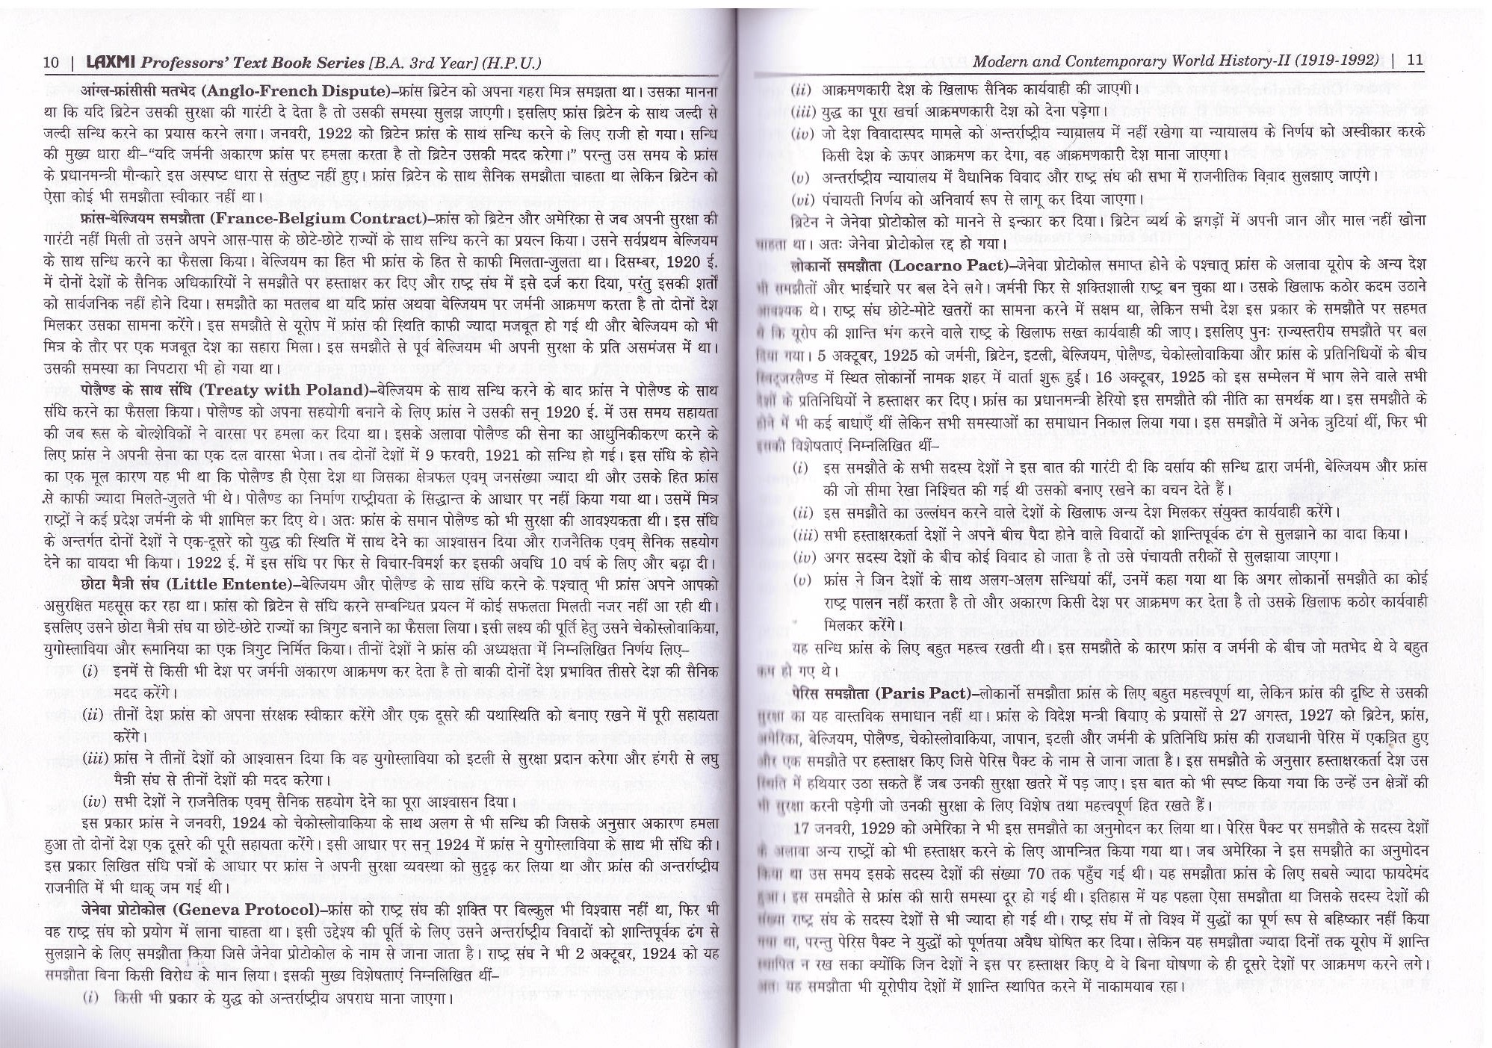

Slide 25
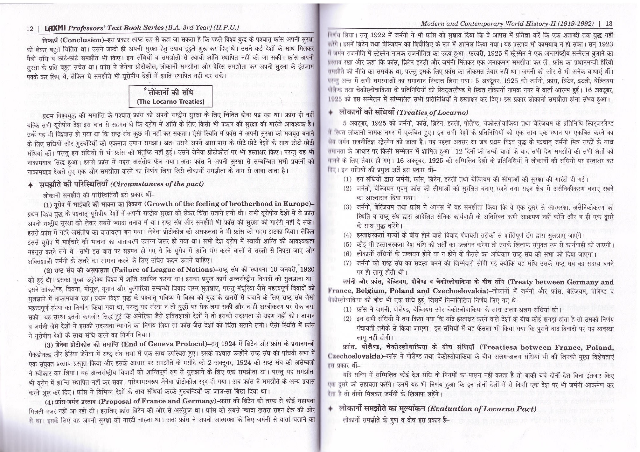
THE LOCARNO TREATIES

Slide 27
TREATIES OF LOCARNO

Slide 28
